Slide 1
CONCEPTUAL DATA MODELLING
CT026-3-1-Systems Analysis and Design

Slide 2
Topic Learning Outcomes
At the end of this topic, you should be able to:
1. Explain Data Dictionary
2. Create a Data Dictionary using an appropriate format / content

Slide 3
Contents & Structure
Data Dictionary
What is a Data Dictionary?
Use of a Data Dictionary
Contents of a Data Dictionary
Data Description
Data Structure
Data Element

Slide 4
Key terms you must be able to use
If you have mastered this topic, you should be able to use the following terms correctly in your assignments and exams:
Data Dictionary
ERD

Slide 5
Recap From Last Lesson
Data flow represents?

Slide 6
WHAT IS A DATA DICTIONARY?
Also known as data repository
A reference work of data about data (metadata) which is compiled by systems analysts to guide them through analysis and design
A central storehouse of information about the system’s data
A document which is used to collect and coordinate specific data terms, as well as confirms what each term mean to different people in the organization

Slide 7
A DATA DICTIONARY IS USED TO :
provide documentation
eliminate redundancy
validate the data flow diagram for completeness & accuracy
provide a starting point for developing screens and reports
determine the contents of data stored in files
develop the logic for data flow diagram processes

Slide 8
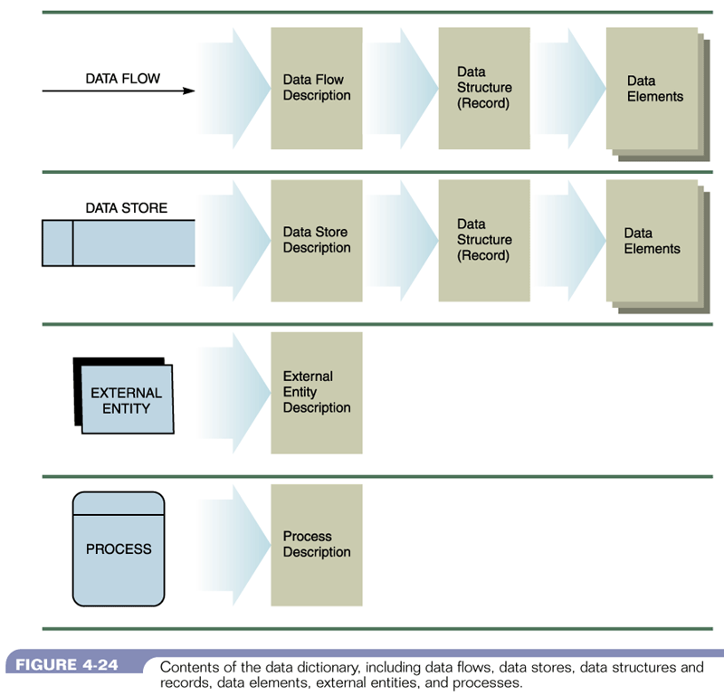
Contents of a data dictionary
Figure 11-1 :Contents of the Data Dictionary
Systems Analysis & Design (4th Edition) – Shelly Cashman Series

Slide 9
External Entity
Name : The external entity name as it appears on the DFDs
Description : Of the external entity and its purpose
Input data flows : The standard DFD names for the input data flows into the external entity
Output data flows : The standard DFD names for the output data flows

Slide 10
External Entity
Name : Customer
Description : Customer register details to obtain
login details such as Login # and
password
Input data flows : Login details
Output data flow : Customer details
Customer record
Registration details
Updated Customer details
1.0
Register
Customer
Customer
Customer details
Login details

Slide 11
Process
Name : Process name and # as it appears on the DFDs
Description : Brief statement of the process’s general purpose
Input data flows : The standard DFD names for the data flows entering the process
Output data flow : The standard DFD names for the data flows leaving the process
Process description : Document the detailed steps for the process – using Structured English

Slide 12
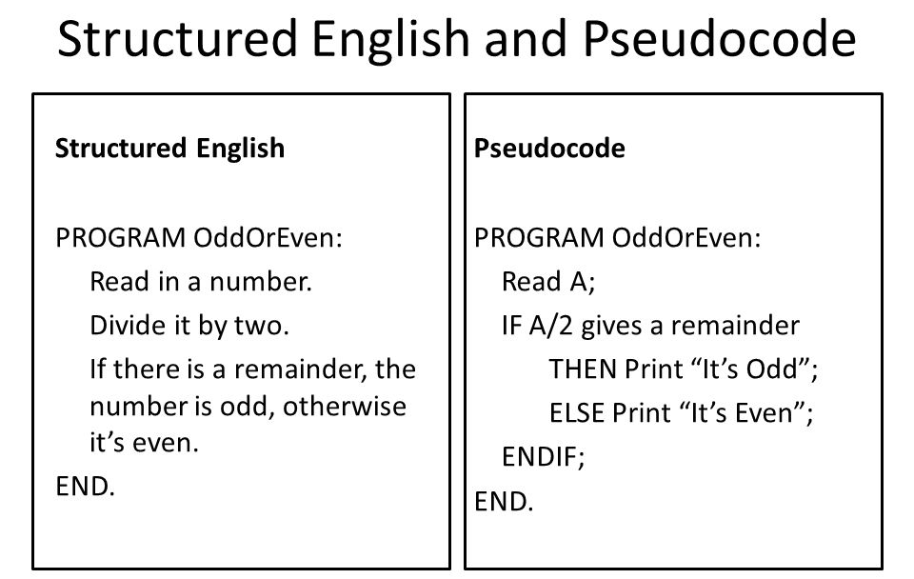

Slide 13
Process
Name : 1.0 Register Customer
Description : Registers customer details into the customer
records and retrieves randomly generated
password with login
Input data flows : Customer details, Updated customer details
Output data flows : Login details, Registration details
Process : (Pseudocode)
Customer record
Registration details
Updated Customer details
1.0
Register
Customer
Customer
Customer details
Login details

Slide 14
Process Pseudocode Example
if(first time entry) {
Load registration form
}
else
{
res_userID = check whether i/p userID is unique
res_pwd = check whether i/p password1 and i/p password2 are the same
res_phone = check whether i/p phone number is 9 digit
res_email = check whether i/p email is of correct format
res_gender = check whether i/p gender has a valid value
res_profile = check whether i/p profile is not empty
res_name = check whether i/p name field is not empty
if( all check results == true)
{
generate SQL insert queries
connect to database
pass queries to database
if (any query fails)
display error msg
else display registration complete msg
endif
}else {
Load registration form
if(res_userID == false)
display reselect unique user id msg
endif

Slide 15
Data Flow
Name : The data flow name as it appears on the DFDs
Description : Describes the data flow and its purpose
Origin / Source : The DFD beginning or source of the data flow. Can be a process, a data store or an external entity.
Destination : The DFD ending points for the data flow. Can be a process, a data store or an external entity
Data structure : Also known as record

Slide 16
Data Flow
Name : Login details
Description : to allow the customer to log on into the system
Origin / Source : Register customer process
Destination / Sink : Customer external entity
Data structure : Login ID, Password
Customer record
Registration details
Updated Customer details
1.0
Register
Customer
Customer
Customer details
Login details

Slide 17
Data Store
Name : The data store name as it appears on the DFDs
Description : Describes the data store and its purpose
Input data flows : The standard DFD names for the data flows entering the data store
Output data flows : The standard DFD names for the data flows leaving the data store
Data structure : Also known as record

Slide 18
Data Store
Name : Customer Record
Description : Stores registration details and provided updated customer details for processes
Input data flows : Registration details
Output data flows : Updated customer details
Data structure : Customer ID, Name, Address, Phone No., email
Customer record
Registration details
Updated Customer details
1.0
Register
Customer
Customer
Customer details
Login details

Slide 19
Quick Review Question
What is the data dictionary format for
entity?
process?
data flow?
data store?

Slide 20
CONTENTS OF A DATA DICTIONARY
Data Structure

Slide 21
Data Structure
described using algebraic notation
The symbols used are :
= means “is composed of”
+ means “and”
{ } indicate repetitive elements, repeating groups or tables
[ ] represent an either / or situation
( ) represent an optional element

Slide 22
Data Structure
Customer order = Customer Number +
Customer Name +
Address +
Telephone +
Order Date +
{Available order items} +
Merchandise Total +
(Tax) +
(Credit Card Type) +
(Credit Card Number)
Method of payment = [Check | Charge | Money Order]

Slide 23
CONTENTS OF A DATA DICTIONARY
Data Element

Slide 24
Data Element
Data Element Name : Login ID
Description : used to uniquely identify the user of the system
Element Characteristics :
Type : Alphanumeric
Length : 7
Output format : xxxxxxx
* other characteristics – refer to Ms Access

Slide 25
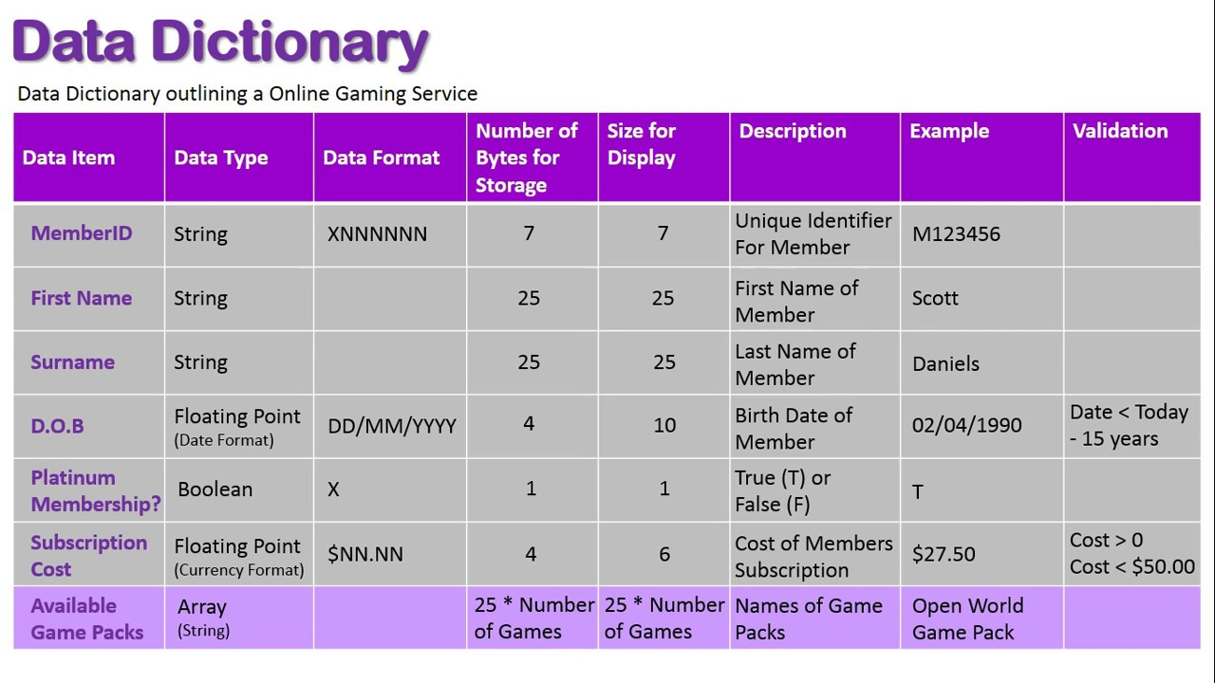
Example in Database Design

Slide 26
After the break
Entity Relationship Diagram
Introduction
Types of Relationship

Slide 27
Learning Outcomes
By the end of this lecture, YOU should be able to :
Draw an Entity Relationship Diagram

Slide 28
Key Terms you must be able to use
If you have mastered this topic, you should be able to use the following terms correctly in your assignments and exams:
Entity Relationship Diagram
Cardinality

Slide 29
Entity Relationship Diagram
A model that shows the logical relationship and interaction among system entities
Provides an overall view of the system and a blueprint for creating the physical structures

Slide 30
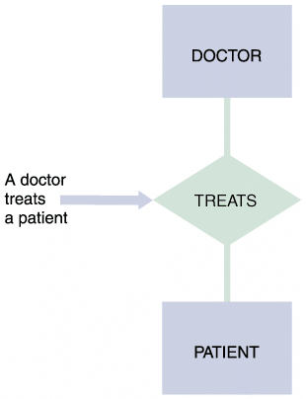
Entity-Relationship Diagrams
Drawing an ERD
The first step is to list the entities that you identified during the systems analysis phase and to consider the nature of the relationships that link them
Types of Relationships
Three types of relationships can exist between entities:
One-to-one
One-to-many
Many-to-many
FIGURE 9-14 In an entity-relationship diagram, entities are labeled with singular nouns and relationships are labeled with verbs. The relationship is interpreted as a simple English sentence.

Slide 31
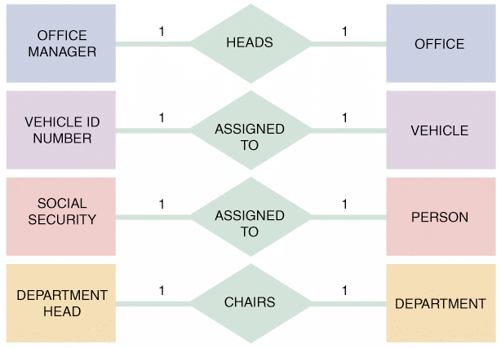
Entity-Relationship Diagrams
A one-to-one relationship, abbreviated 1:1, exists when exactly one of the second entity occurs for each instance of the first entity
Figure 9-15 shows examples of several 1:1 relationships
A number 1 is placed alongside each of the two connecting lines to indicate the 1:1 relationship
FIGURE 9-15 Examples of one-to-one (1:1) relationships

Slide 32
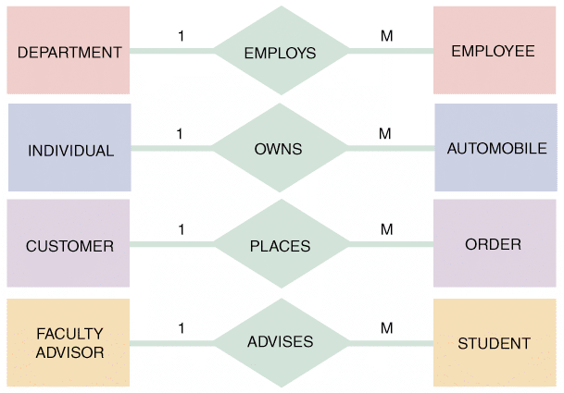
Entity-Relationship Diagrams
A one-to-many relationship, abbreviated 1:M, exists when one occurrence of the first entity can relate to many instances of the second entity, but each instance of the second entity can associate with only one instance of the first entity
FIGURE 9-16 Examples of one-to-many (1:M) relationships

Slide 33
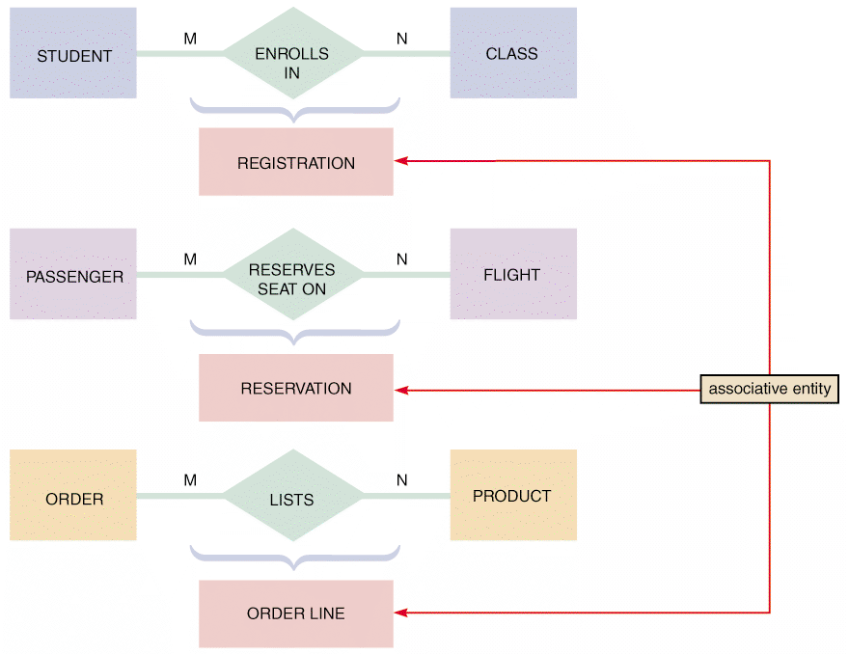
Entity-Relationship Diagrams
A many-to-many relationship, abbreviated M:N, exists when one instance of the first entity can relate to many instances of the second entity, and one instance of the second entity can relate to many instances of the first entity
FIGURE 9-17 Examples of many-to-many (M:N) relationships. Notice that the event or transaction that links the two entities is an associative entity with its own set of attributes and characteristics

Slide 34
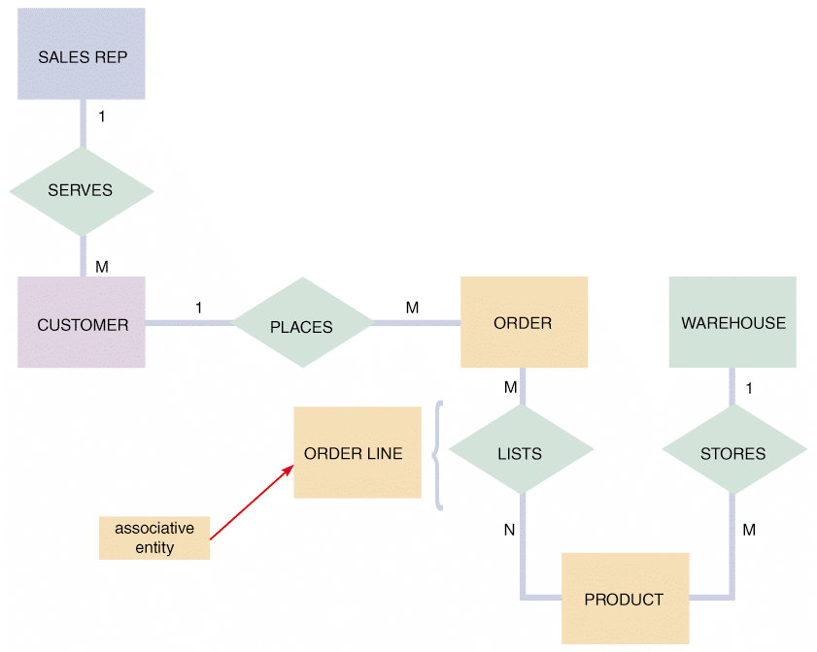
Entity-Relationship Diagrams
FIGURE 9-18 An entity-relationship diagram for SALES REP, CUSTOMER, ORDER, PRODUCT, and WAREHOUSE. Notice that the ORDER and PRODUCT entities are joined by an associative entity named ORDER LINE

Slide 35
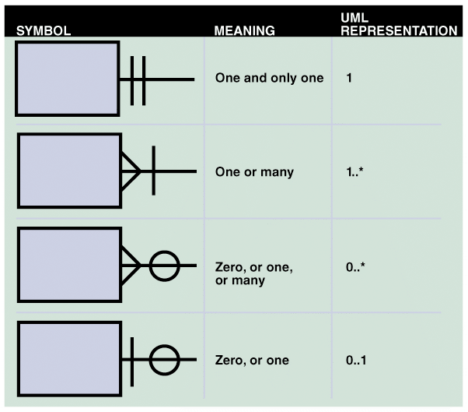
Entity-Relationship Diagram
Cardinality
Describes the numeric relationship between two entities and shows how instances of one entity relate to instances of another entity
A common method of cardinality notation is called crow’s foot notation because of the shapes, which include circles, bars, and symbols, that indicate various possibilities
FIGURE 9-19 Crow’s foot notation is a common method of indicating cardinality. The four examples show how you can use various symbols to describe the relationships between entities

Slide 36
Entity-Relationship Diagram (
Cardinality
Describes the numeric relationship between two entities and shows how instances of one entity relate to instances of another entity
A common method of cardinality notation is called crow’s foot notation because of the shapes, which include circles, bars, and symbols, that indicate various possibilities
FIGURE 9-19 Crow’s foot notation is a common method of indicating cardinality. The four examples show how you can use various symbols to describe the relationships between entities

Slide 37
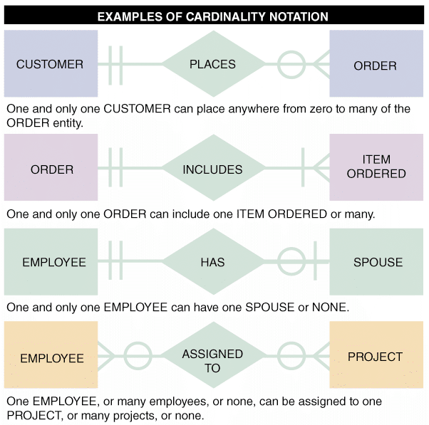
Entity-Relationship Diagrams
FIGURE 9-20 In the first example of cardinality notation, one and only one CUSTOMER can place anywhere from zero to many of the ORDER entity. In the second example, one and only one ORDER can include one ITEM ORDERED or many. In the third example, one and only one EMPLOYEE can have one SPOUSE or none. In the fourth example, one EMPLOYEE, or many employees, or none, can be assigned to one PROJECT, or many projects, or none

Slide 38
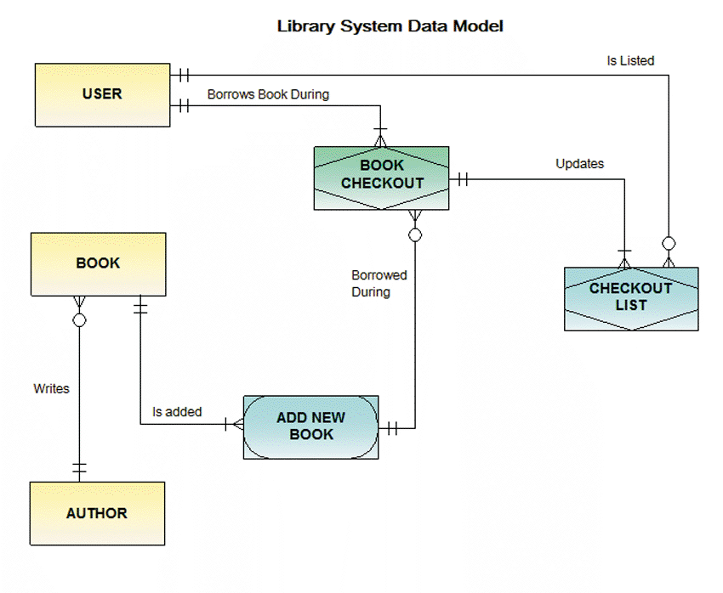
Entity-Relationship Diagrams
FIGURE 9-21 An ERD for a library system drawn with Visible Analyst. Notice that crow’s foot notation has been used and relationships are described in both directions

Slide 39
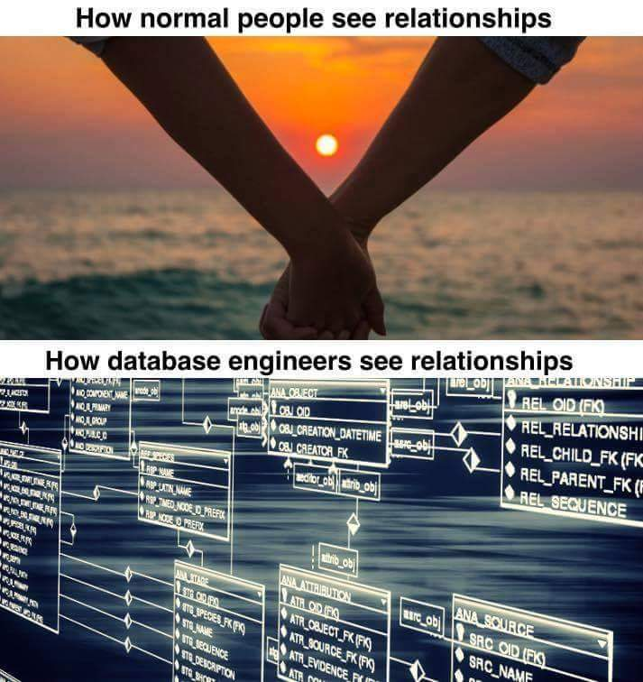

Slide 40
Summary
Data Dictionary
What is a Data Dictionary?
Use of a Data Dictionary
Contents of a Data Dictionary
Data Description
Data Structure
Data Element
Entity Relationship Diagram
Introduction
Types of Relationship

Slide 41
Question and Answer Session
Q & A

Slide 42
What To Expect Next Week
In Class
Preparation for Class
Interface design
Input Design
Objectives
Devices
Guidelines for form design
Download the slide and study for the next chapter.

